Slide 1

IES PROJECT ASP .NET CORE WEB APPLICATION
Group Members:-
Tisha Arora-200591979
Amanpreet Kaur – 200564069
Vaibhav Patel – 200592458
Manya - 200584753

Slide 2
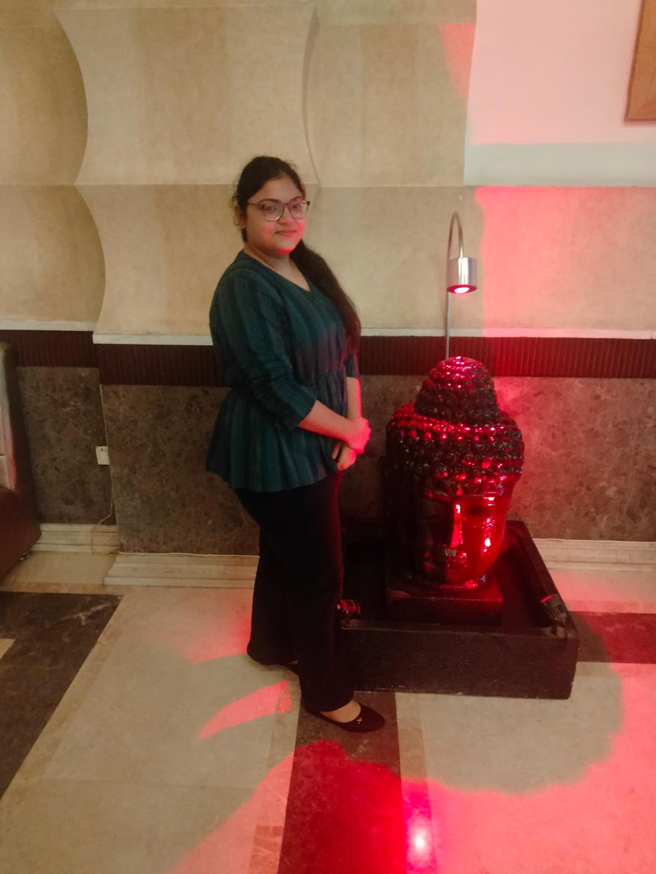



Team Members
Tisha arora(200591979)
Bachelors in Science and
Mathematics
Amanpreet Kaur(200564069)
Bachelors in Mathematics
Honors
Vaibhav patel(200592458)
P.G diploma in Project Management.
Manya(200584753)
Bachelors in Computer
Applications.

Slide 3
Table of contents
Introduction
Tools used
Home page
Registration
Login view
User viewpoint
Manager viewpoint
Admin viewpoint
Solution explorer view
Conclusion
Contact data in Sql

Slide 4
Introduction
A user-authenticated web application is explained in this powerpoint presentation which has three main security groups which are explained as follows:
Registered User :- User can login and see contacts, add new contacts.
Manager :- Manager can view contacts, add contacts, accept reject them
Administrator :- Admin can create contacts, provide acceptance or rejection and also edit and delete the listed contacts.

Slide 5
Tools used
ASP.NET :- Visual studio was used to create website and make required changes.
HTML $ CSS :- these were used for the development of the code.
SSMS :- This was used to run queries.

Slide 6
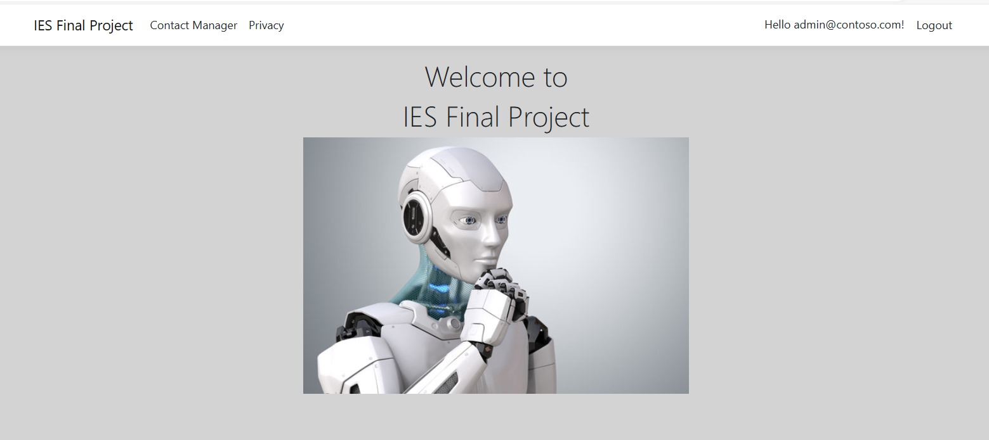
Home Page view
This is the first view of webside upon opening the link.

Slide 7
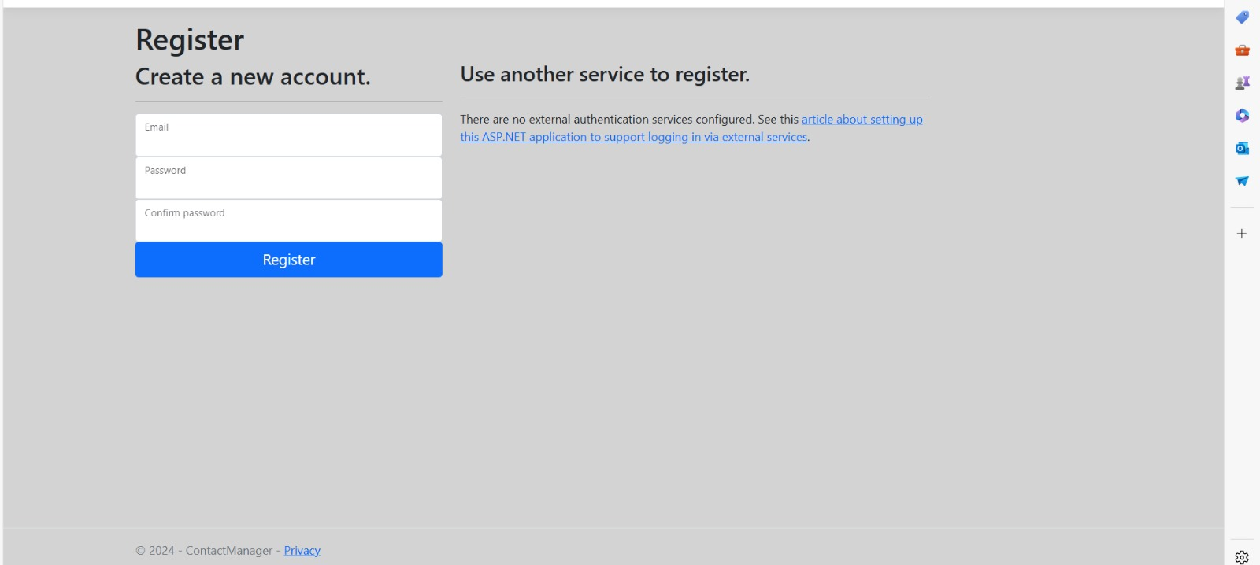
Registration :- Here we can fill in our mail id and create a new account by confirming the password.

Slide 8
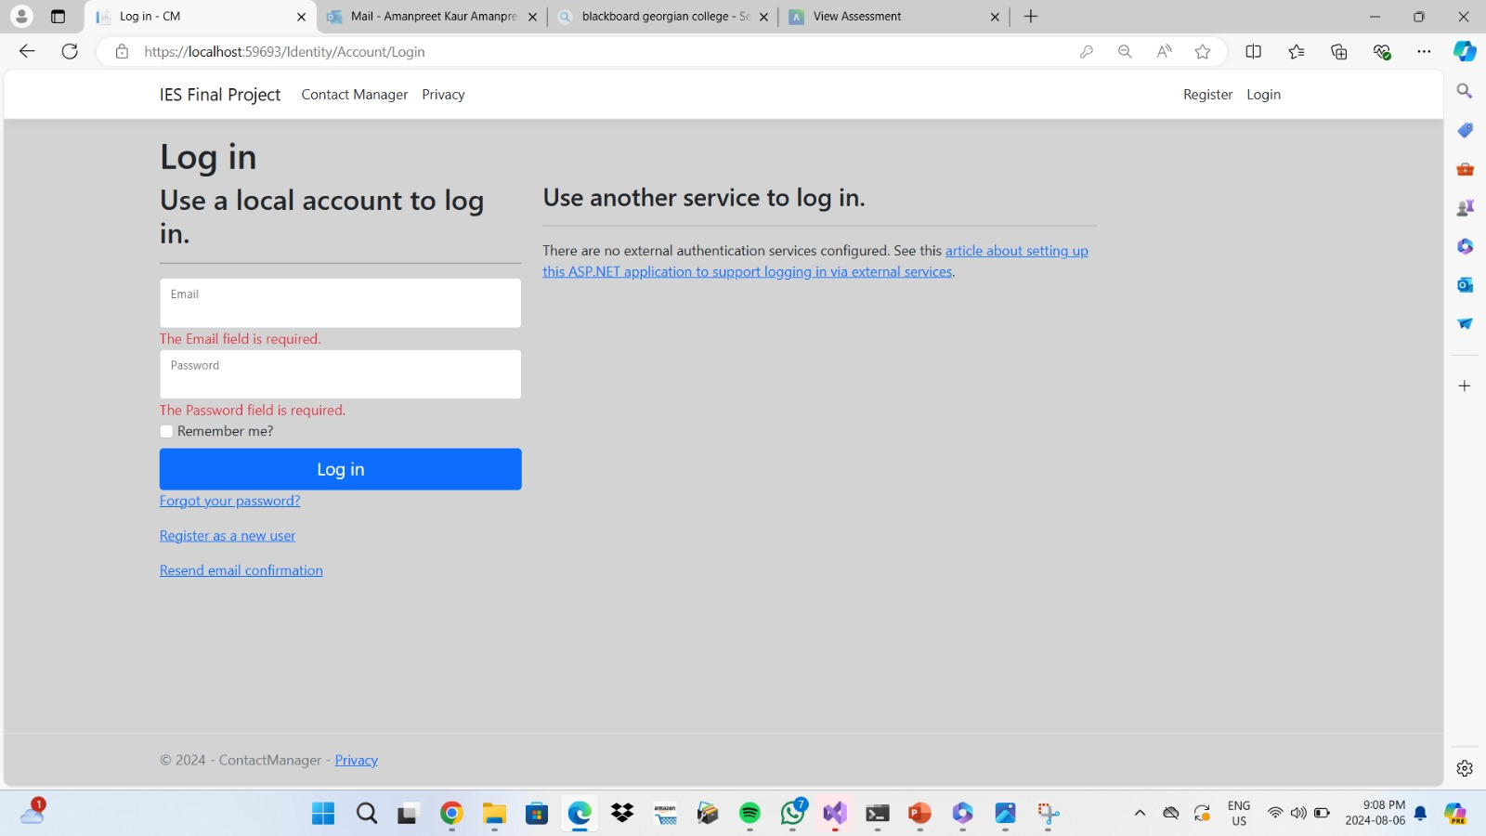
Login

Slide 9
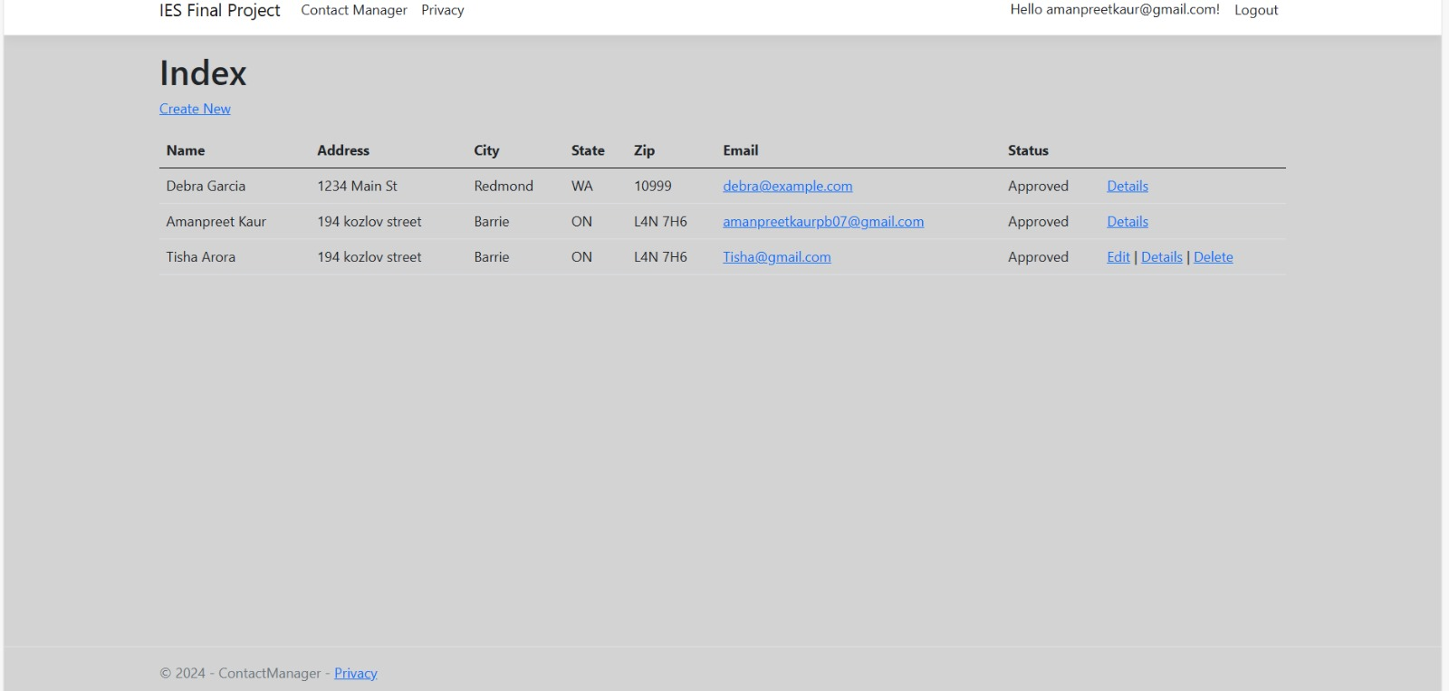
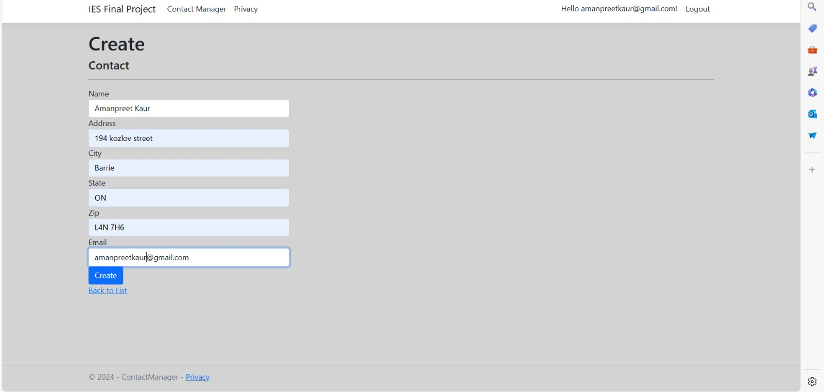
User viewpoint :- Here, after loging in, user can see details of listed contacts and can make new

Slide 10
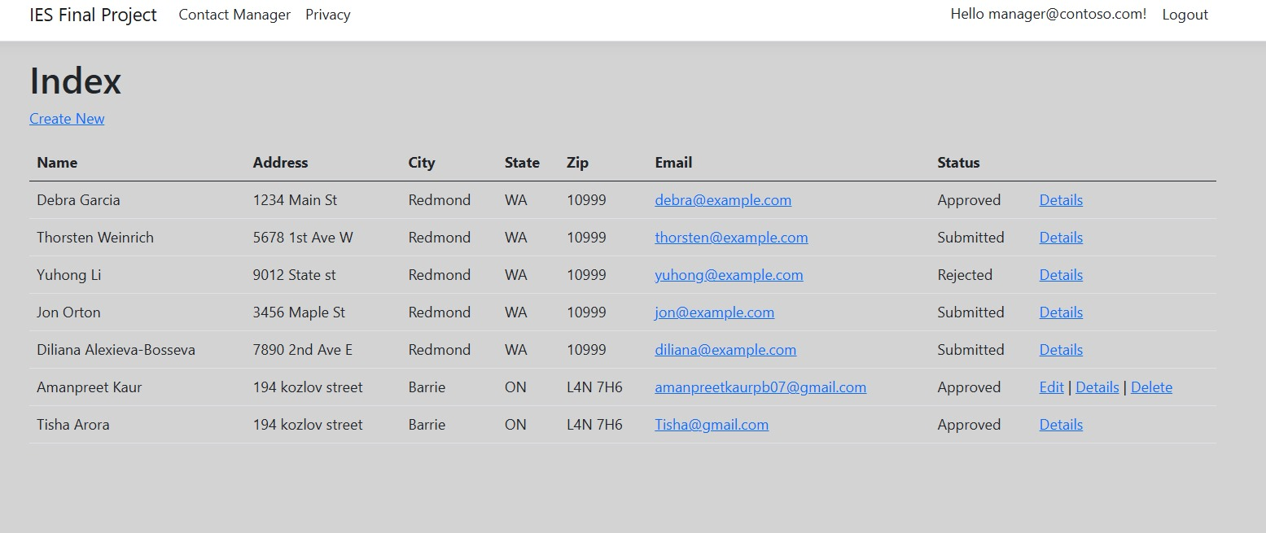
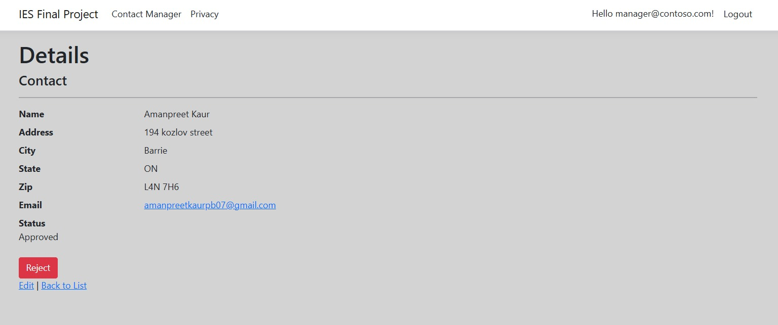
Manager viewpoint
As we can see, manager can see details of the listed member and can can create new member and also can reject the accounts listed.

Slide 11
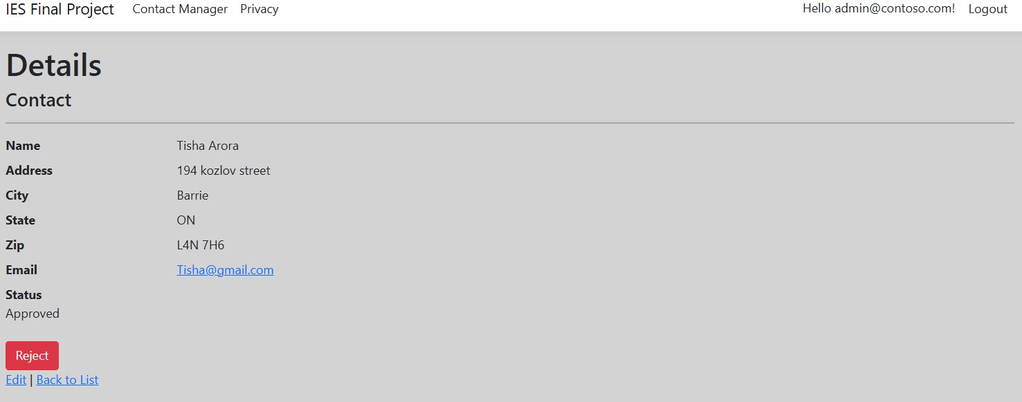
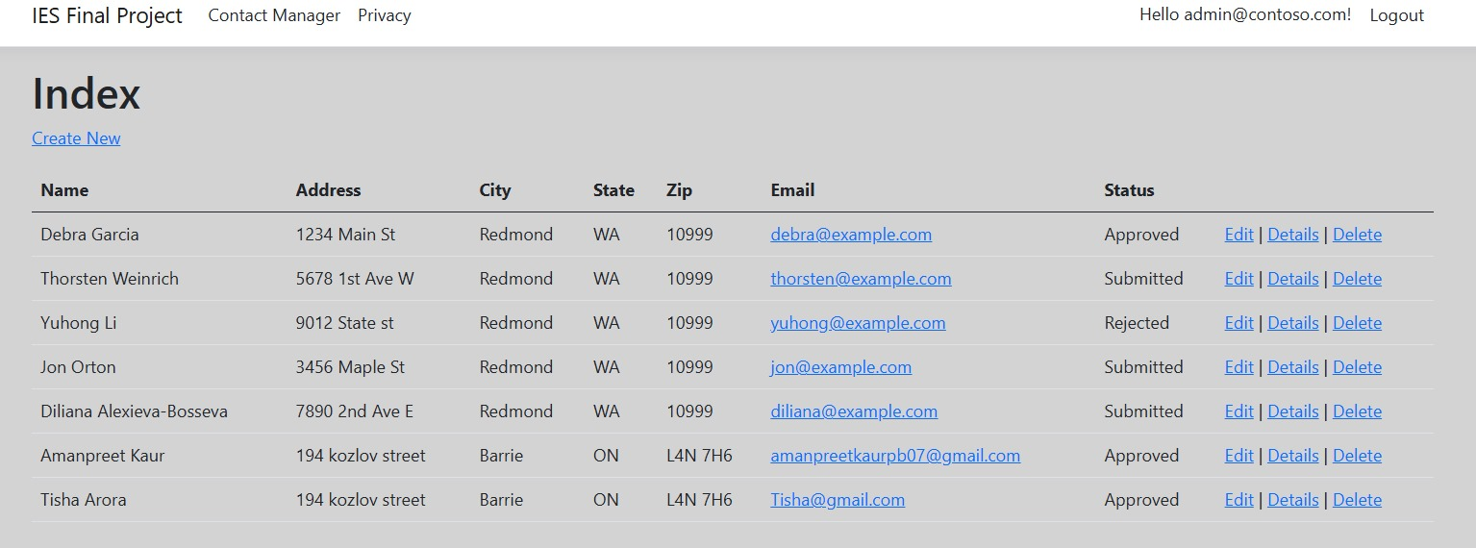
Admin Viewpoint
Likewise, admin can edit,delete or look at the details of the listed persons and can reject them as per his wish.

Slide 12
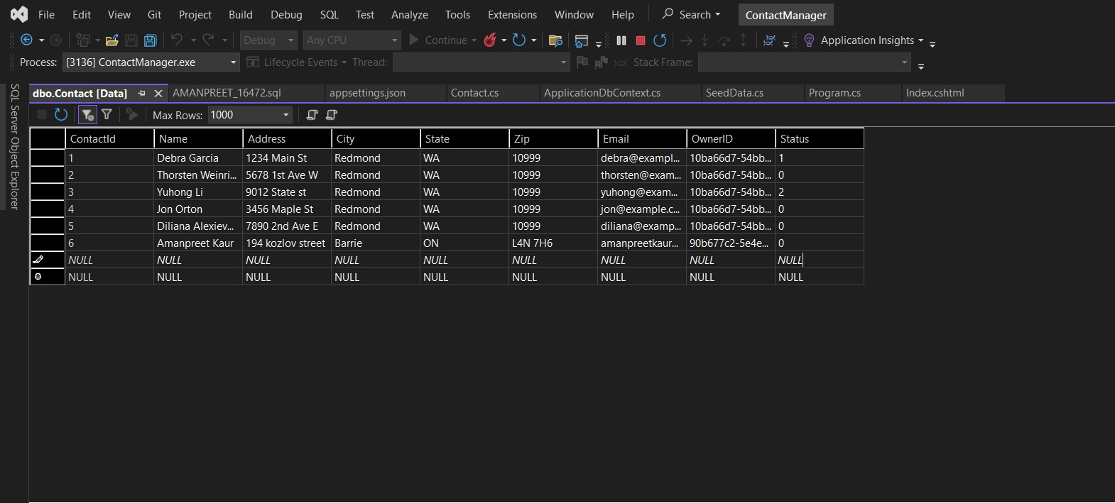
Contact data in SQL

Slide 13
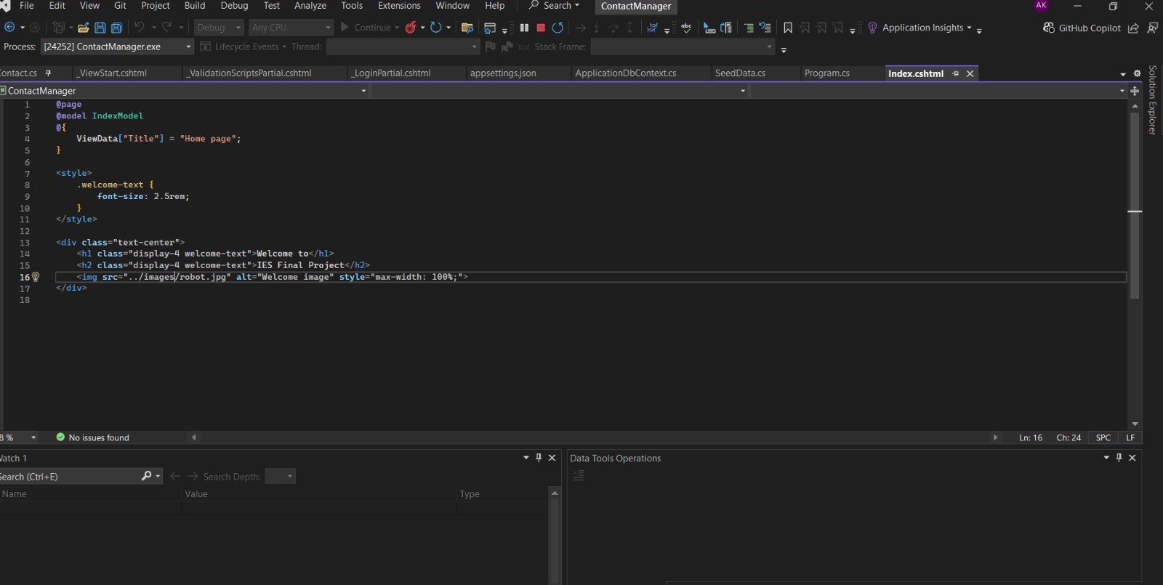
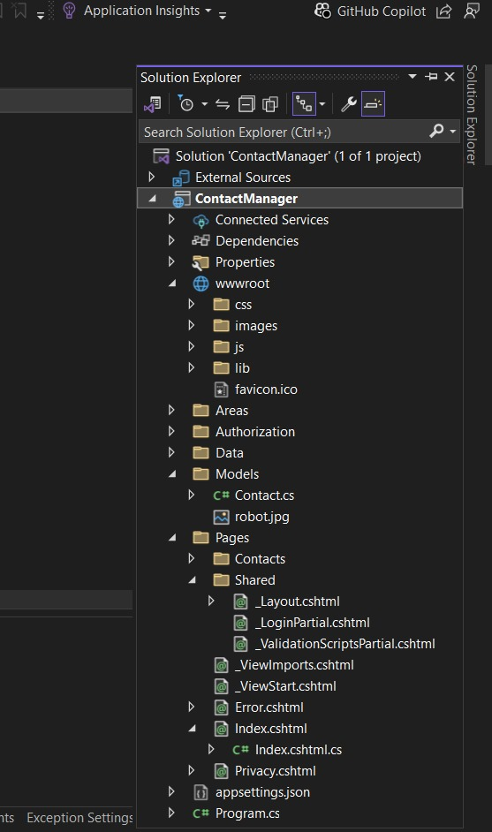
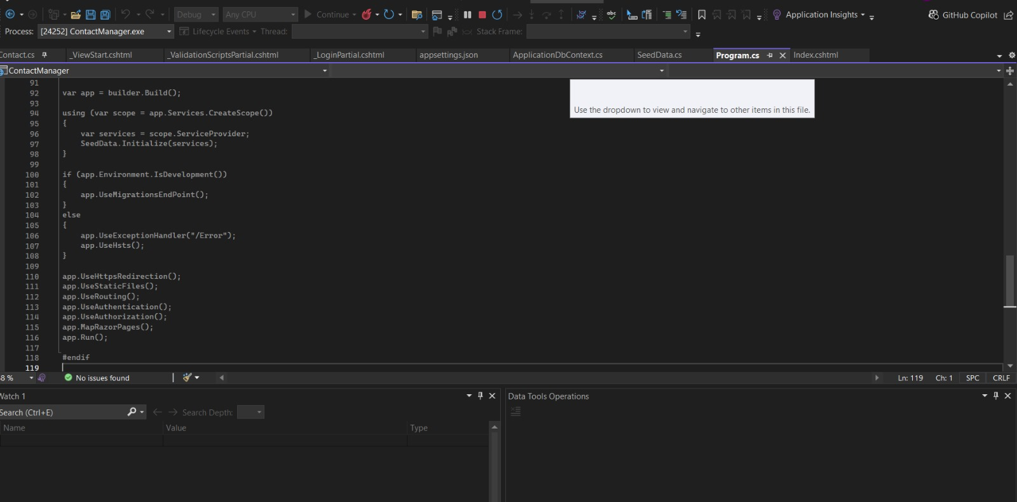
Solution Explorer and significant code used

Slide 14
Potential Improvements
Advanced security featured can be added to the ASP.NET Wed application.
Introducing advanced visualisation using HTML5 and CSS3 for enhanced user experience.
Authentication can be added for admin in order to protect sensitive information.

Slide 15
Conclusion
This ASP.NET Core web application is a user-authorised application where we there are three security groups namely , user,manager,admin who have their own significant roles.By utilising essential tools such as C#,HTML AND CSS ,we have created a responsive platform. Upcoming improvements will definitely raise the bar of this platform and will take user experience to next level.

Slide 16
Thank you

